Slide 1
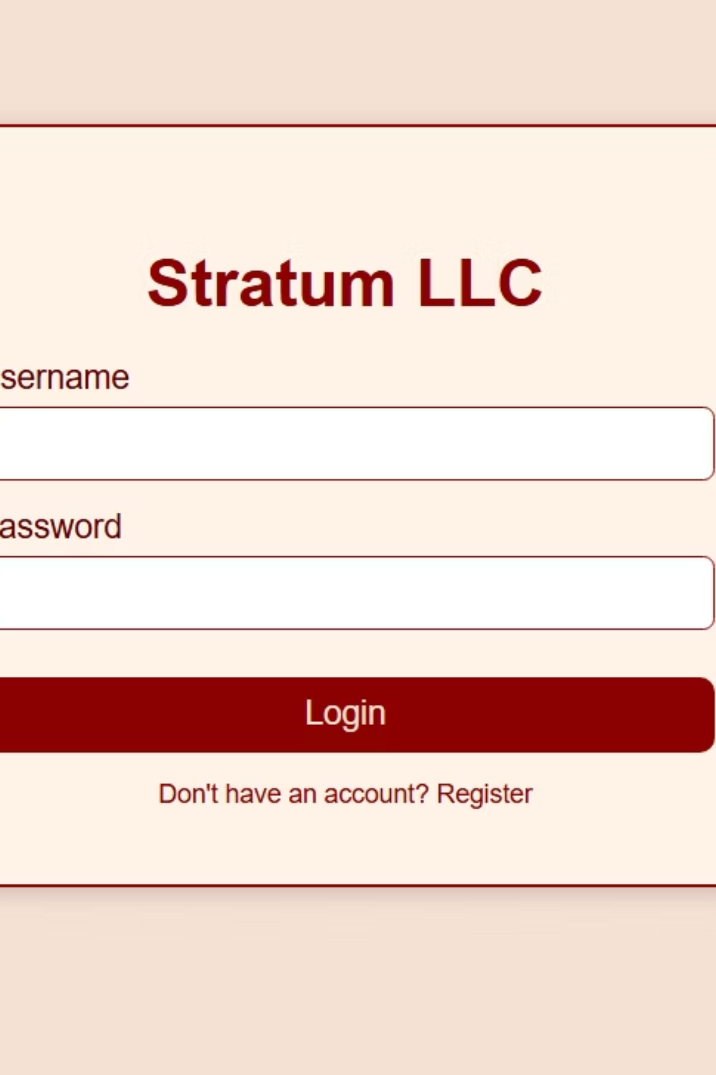
Stratum LLC – Capstone Project
Secure Instructor Marketplace App
Your name, course, date

Slide 2
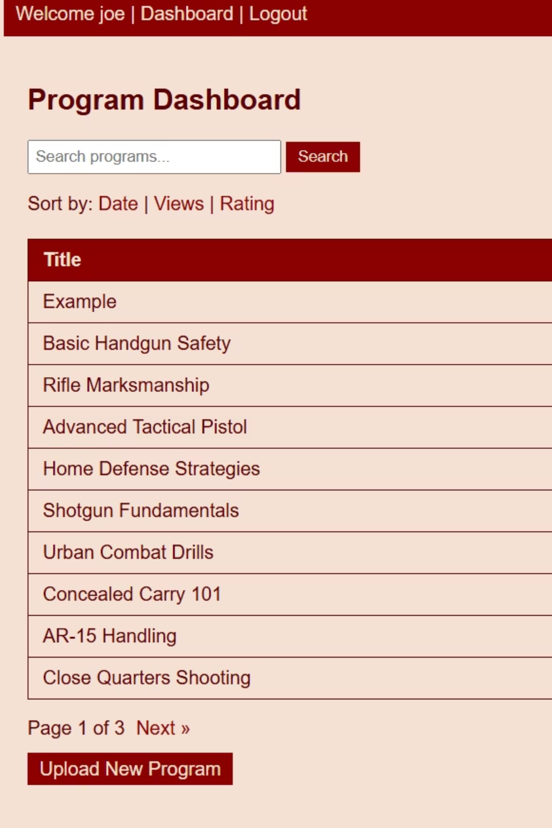
Project Overview
Stratum LLC allows instructors to upload and sell instructional programs.
Key features:
login
upload
dashboard
purchase wall

Slide 3

Technology Stack
Backend:
Python + Flask
Frontend
HTML/CSS templates
Frontend:
HTML/CSS templates
Three-tier Architecture
Database:
SQLite
Security:
Database
Backend
SQLite storage
Python + Flask
hashed passwords
login-required routes
admin backdoor

Slide 4
Database & Data Flow
Table Name
Key Fields
Users
id, username, password_hash
Tables: users, programs, purchases
Programs
id, title, description, price, instructor_id
Parameterized queries prevent SQL injection
Seeded program data for testing
Purchases
id, user_id, program_id, purchase_date

Slide 5
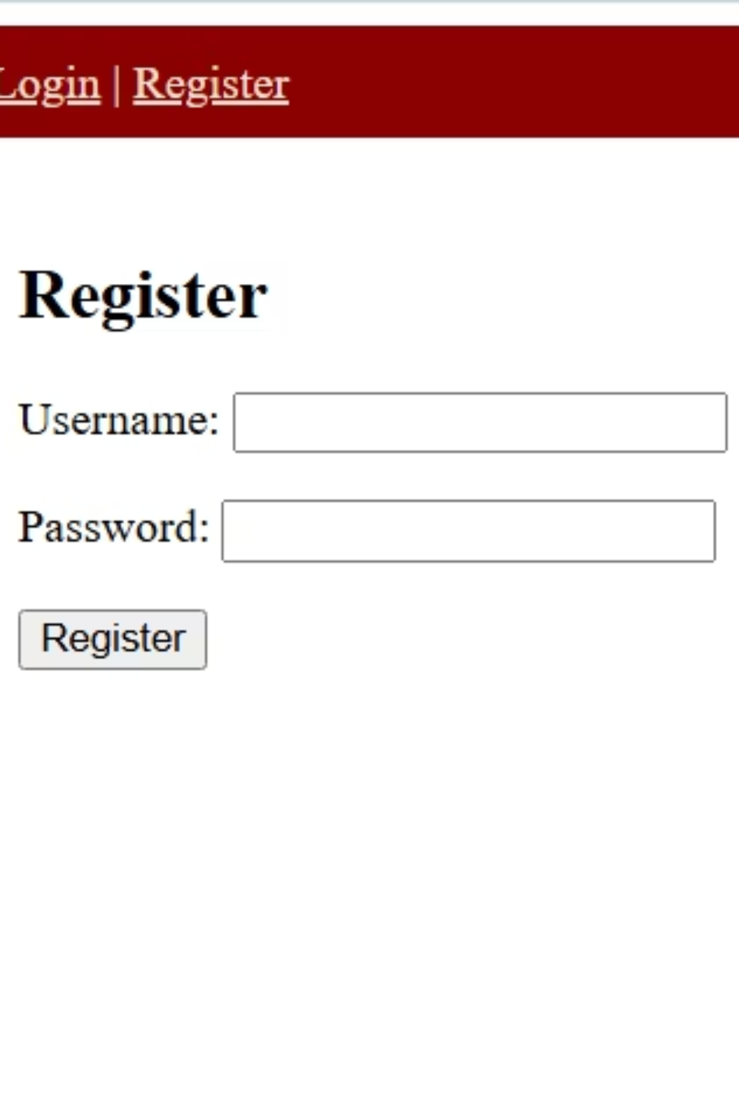
User Authentication
Registration & login flow
Hashed password storage
Admin-only routes and access control

Slide 6
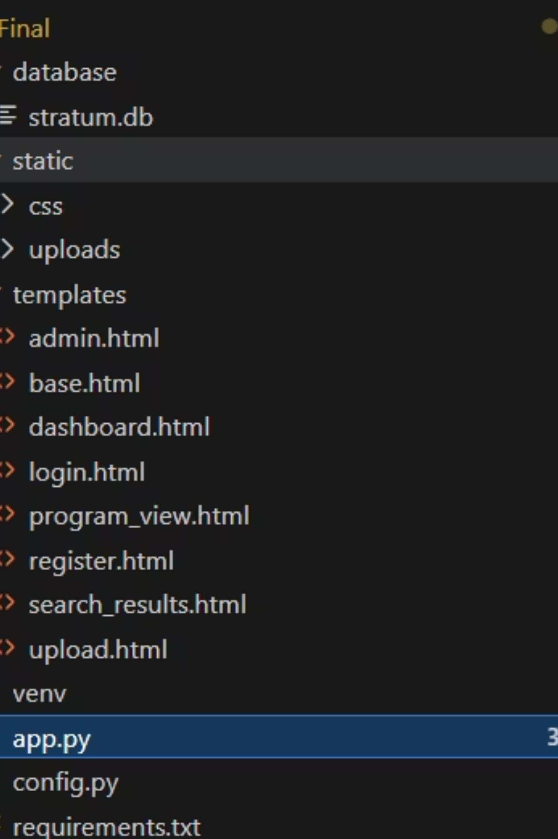
Program Management
Upload programs via dashboard
View program details (title, rating, views, upload date)
Sorting by rating, views, recency

Slide 7
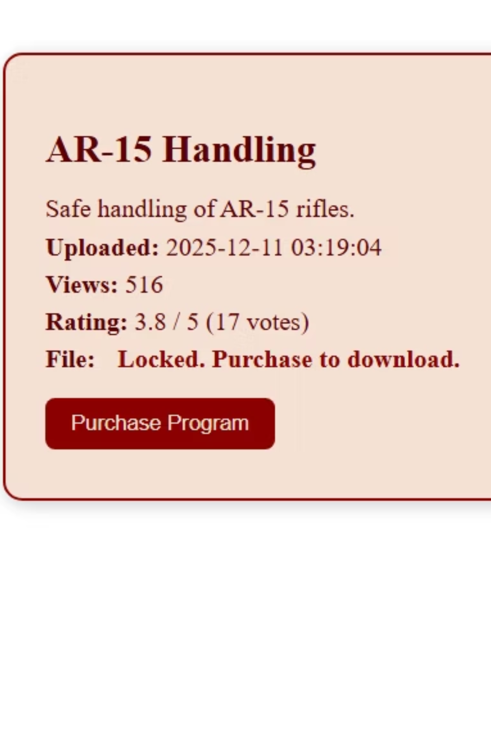
Purchase Wall
Programs locked until purchase
File download available only post-purchase
Purchase recorded in database

Slide 8
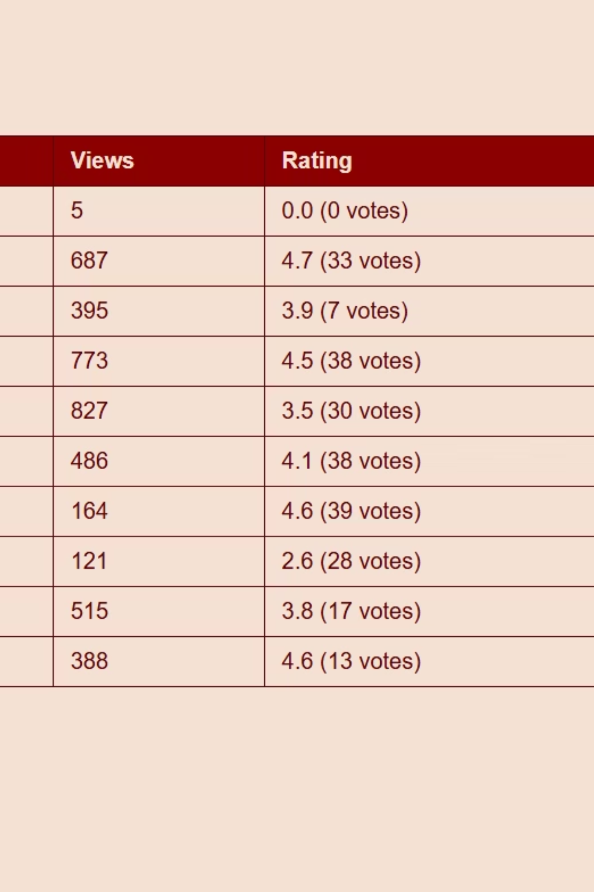
Ratings & Views
Users rate purchased programs (1–5 stars)
Views increment automatically on access

Slide 9
Security Features
SQL injection prevention (parameterized queries)
Access control with login_required
Admin backdoor restricted
Virtual environment (venv) + WSL2 isolation
SQL injection prevention
Parameterized queries
Access control
login_required decorator
Admin backdoor
Restricted access
Environment isolation
venv + WSL2

Slide 10
Static & Dynamic Analysis
Static: Code review for vulnerabilities
Dynamic: Tested purchase wall, rating, uploads
Findings: Unpurchased access blocked, ratings restricted
Unpurchased program access
Blocked
Rating submission
Restricted to purchased programs
Program uploads
Successful

